Slide 1

Queues
Data Structures

Slide 2
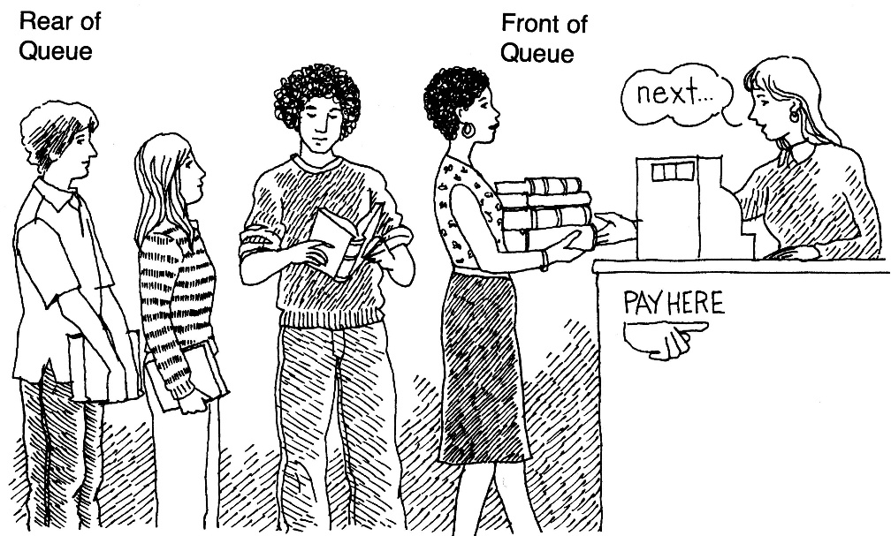
What is a queue?
It is an ordered group of homogeneous items of elements.
Queues have two ends:
Elements are added at one end.
Elements are removed from the other end.
The element added first is also removed first (FIFO: First In, First Out).

Slide 3
Queue Specification
Definitions: (provided by the user)
MAX_ITEMS: Max number of items that might be on the queue
ItemType: Data type of the items on the queue
Operations
MakeEmpty
Boolean IsEmpty
Boolean IsFull
Enqueue (ItemType newItem)
Dequeue (ItemType& item)

Slide 4
Enqueue (ItemType newItem)
Function: Adds newItem to the rear of the queue.
Preconditions: Queue has been initialized and is not full.
Postconditions: newItem is at rear of queue.

Slide 5
Dequeue (ItemType& item)
Function: Removes front item from queue and returns it in item.
Preconditions: Queue has been initialized and is not empty.
Postconditions: Front element has been removed from queue and item is a copy of removed element.

Slide 6
Implementation issues
Implement the queue as a circular structure.
How do we know if a queue is full or empty?
Initialization of front and rear.
Testing for a full or empty queue.

Slide 7
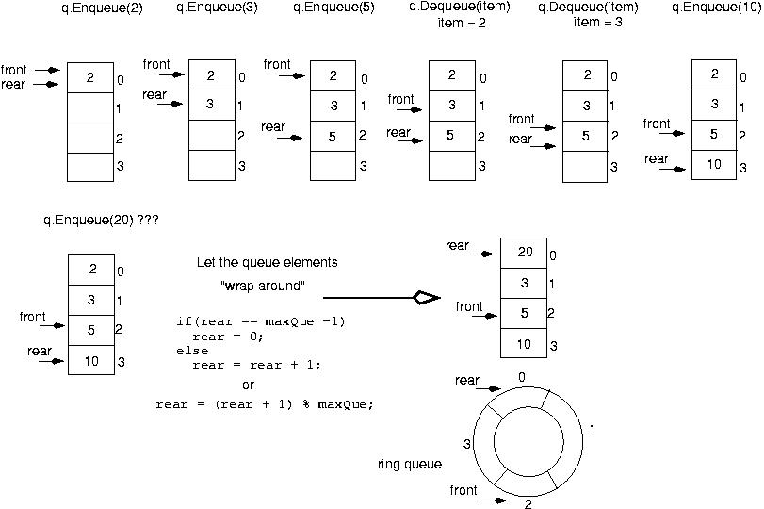

Slide 8
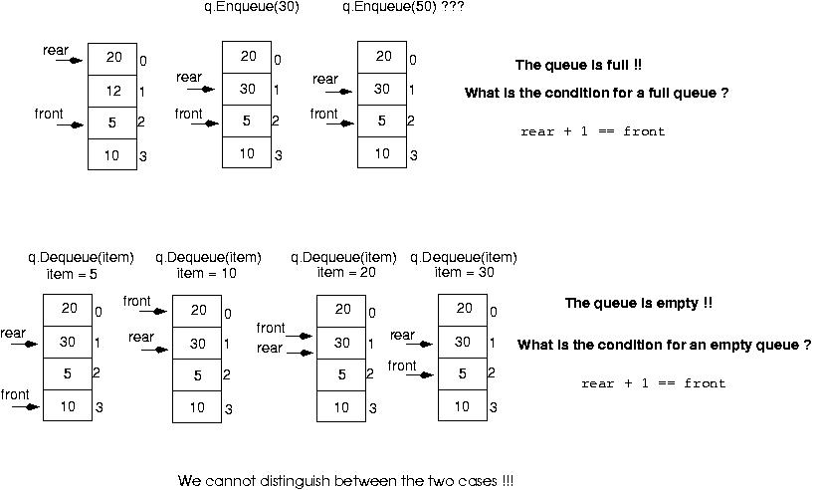

Slide 9
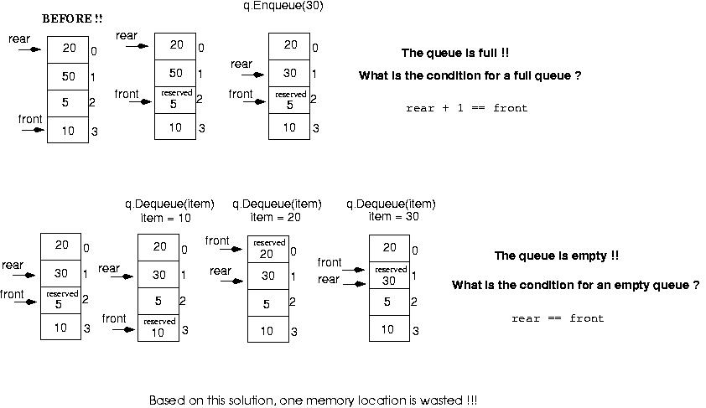
Make front point to the element preceding the front element in the queue (one memory location will be wasted).

Slide 10
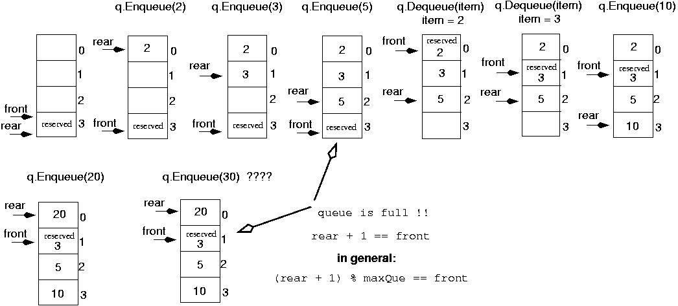
Initialize front and rear

Slide 11
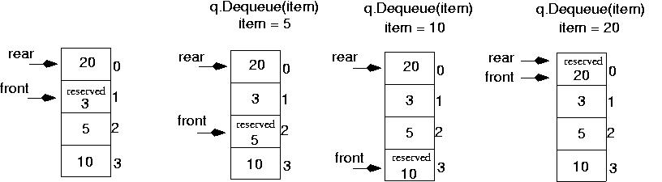
Queue is empty now!!
rear == front

Slide 12
Queue Implementation
template<class ItemType>
class QueueType {
public:
QueueType(int);
QueueType();
~QueueType();
void MakeEmpty();
bool IsEmpty() const;
bool IsFull() const;
void Enqueue(ItemType);
void Dequeue(ItemType&);
private:
int front;
int rear;
ItemType* items;
int maxQue;
};

Slide 13
Queue Implementation (cont.)
template<class ItemType>
QueueType<ItemType>::QueueType(int max)
{
maxQue = max + 1;
front = maxQue - 1;
rear = maxQue - 1;
items = new ItemType[maxQue];
}

Slide 14
Queue Implementation (cont.)
template<class ItemType>
QueueType<ItemType>::~QueueType()
{
delete [] items;
}

Slide 15
Queue Implementation (cont.)
template<class ItemType>
void QueueType<ItemType>:: MakeEmpty()
{
front = maxQue - 1;
rear = maxQue - 1;
}

Slide 16
Queue Implementation (cont.)
template<class ItemType>
bool QueueType<ItemType>::IsEmpty() const
{
return (rear == front);
}
template<class ItemType>
bool QueueType<ItemType>::IsFull() const
{
return ( (rear + 1) % maxQue == front);
}

Slide 17
Queue Implementation (cont.)
template<class ItemType>
void QueueType<ItemType>::Enqueue (ItemType newItem)
{
rear = (rear + 1) % maxQue;
items[rear] = newItem;
}

Slide 18
Queue Implementation (cont.)
template<class ItemType>
void QueueType<ItemType>::Dequeue (ItemType& item)
{
front = (front + 1) % maxQue;
item = items[front];
}

Slide 19
Queue overflow
The condition resulting from trying to add an element onto a full queue.
if(!q.IsFull())
q.Enqueue(item);

Slide 20
Queue underflow
The condition resulting from trying to remove an element from an empty queue.
if(!q.IsEmpty())
q.Dequeue(item);

Slide 21
Example: recognizing palindromes
A palindrome is a string that reads the same forward and backward.
Able was I ere I saw Elba
We will read the line of text into both a stack and a queue.
Compare the contents of the stack and the queue character-by-character to see if they would produce the same string of characters.

Slide 22
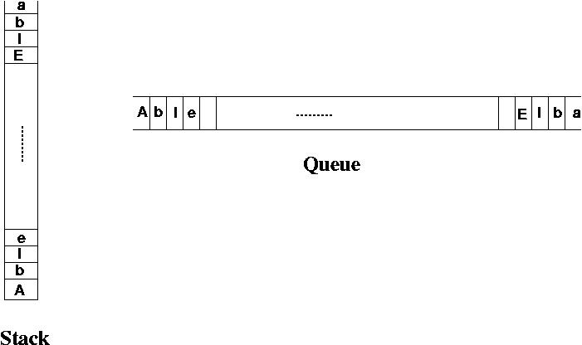
Example: recognizing palindromes

Slide 23
Example: recognizing palindromes
#include <iostream.h>
#include <ctype.h>
#include "stack.h"
#include "queue.h“
int main()
{
StackType<char> s;
QueType<char> q;
char ch;
char sItem, qItem;
int mismatches = 0;
cout << "Enter string: " << endl;
while(cin.peek() != '\\n') {
cin >> ch;
if(isalpha(ch)) {
if(!s.IsFull())
s.Push(toupper(ch));
if(!q.IsFull())
q.Enqueue(toupper(ch));
}
}

Slide 24
Example: recognizing palindromes
while( (!q.IsEmpty()) && (!s.IsEmpty()) ) {
s.Pop(sItem);
q.Dequeue(qItem);
if(sItem != qItem)
++mismatches;
}
if (mismatches == 0)
cout << "That is a palindrome" << endl;
else
cout << That is not a palindrome" << endl;
return 0;
}

Slide 25
Case Study: Simulation
Queuing System: consists of servers and queues of objects to be served.
Simulation: a program that determines how long items must wait in line before being served.

Slide 26
Case Study: Simulation (cont.)
Inputs to the simulation:
(1) the length of the simulation
(2) the average transaction time
(3) the number of servers
(4) the average time between job arrivals

Slide 27
Case Study: Simulation (cont.)
Parameters the simulation must vary:
(1) number of servers
(2) time between arrivals of items
Output of simulation: average wait time.

